Slide 1
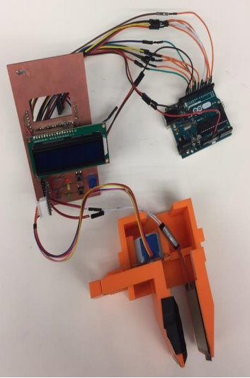
Claw Arm
Christian Crowley
Yunsik Jung
Matthew Stanley

Slide 2
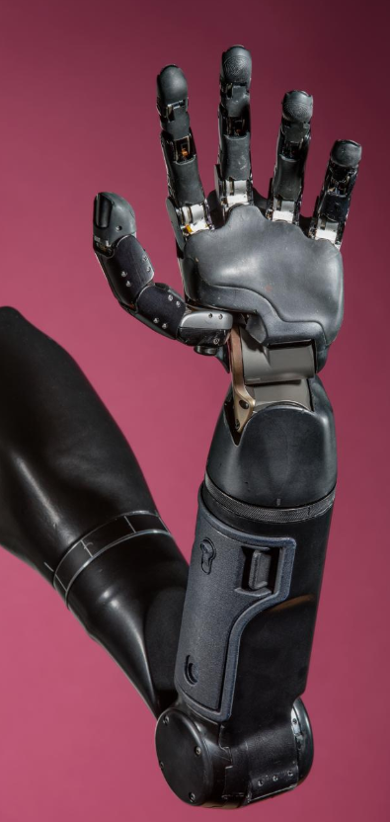
Overview
Complex Robotic hands exist in the market
Without nervous system integration they are hard to control
Prosthetics with limited degrees of freedom are still valuable given todays technology
Proposed Gripper that is controlled through pressure

Slide 3
Requirements
Project Requirements
Incorporate a Custom PCB
One Sensor and One Actuator
System Requirements
Grab an Object
Detect when Object is Grabbed
Output Size of the Object

Slide 4
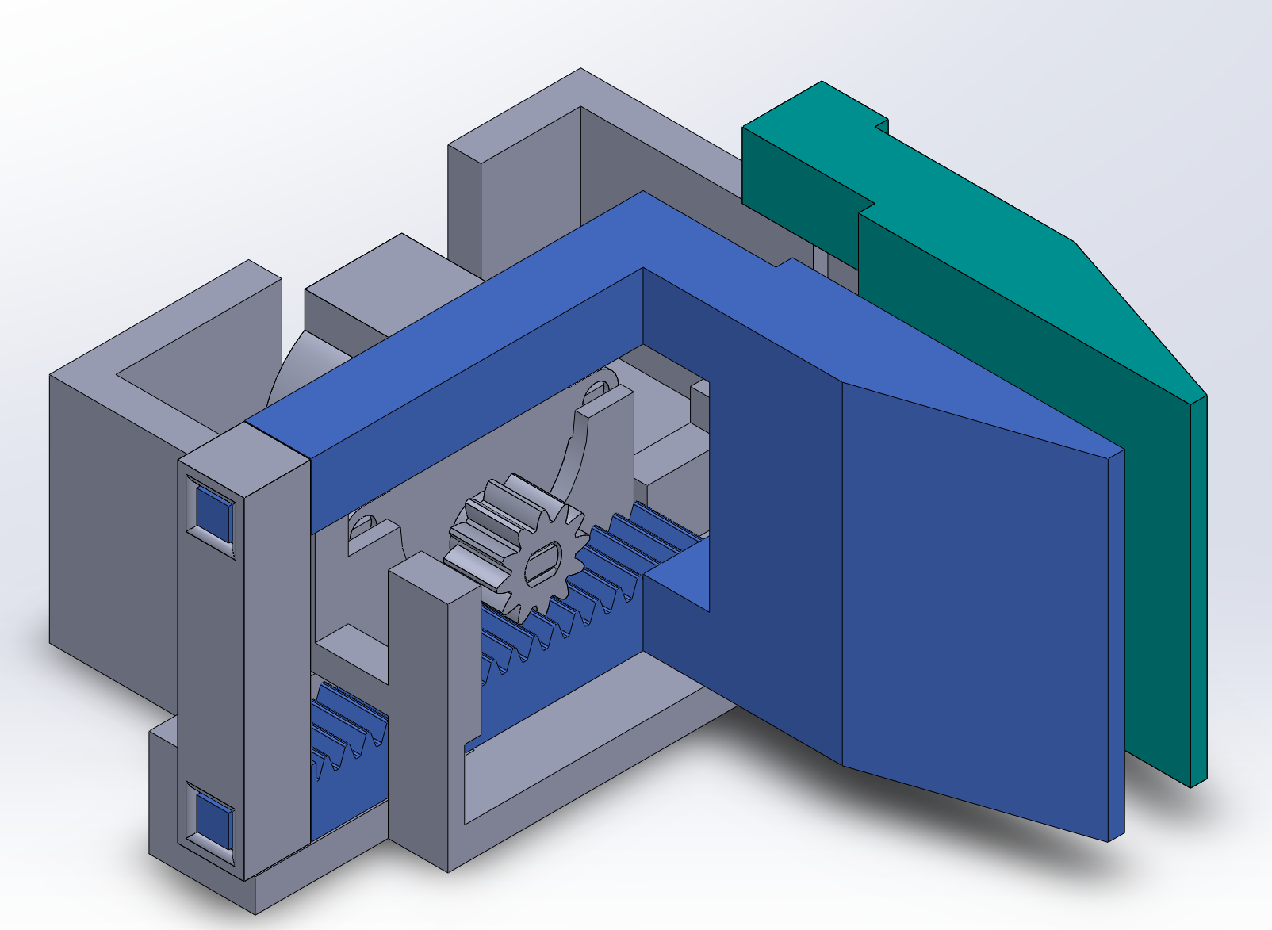
Mechanical Design
All components 3D printed
One claw is mobile and one is stationary
Rack and Pinion gear set for actuation

Slide 5
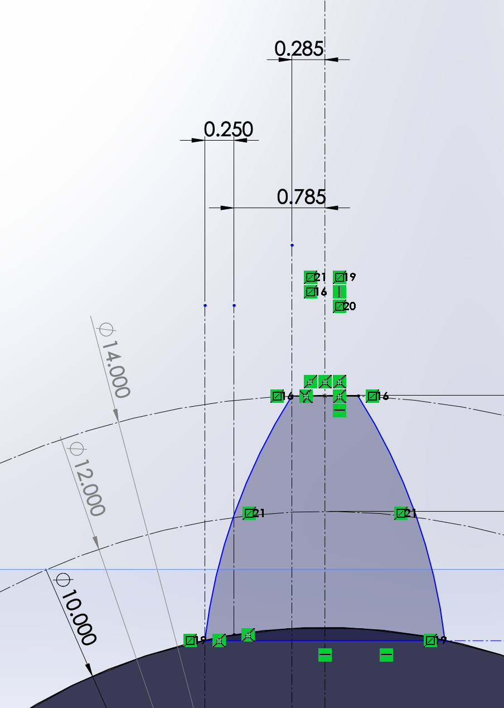
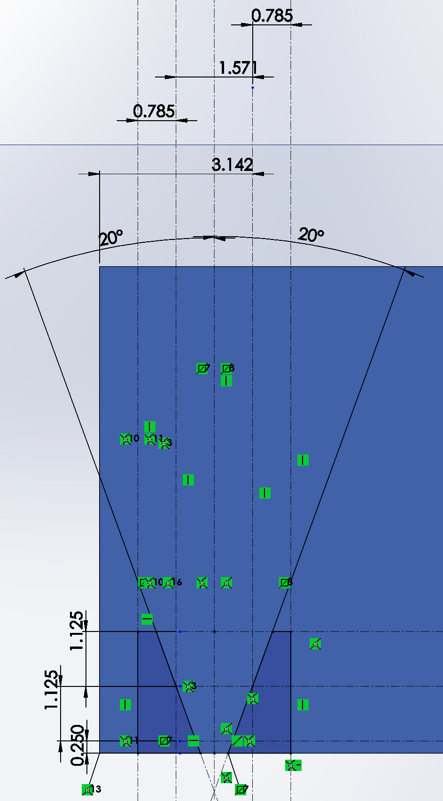
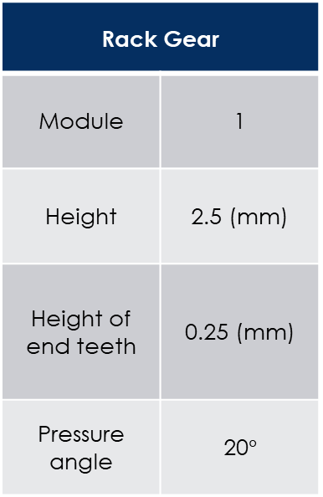
Mechanical Design
Spur Gear
Module | 1
Number of teeth | 12
Pitch Circle Diameter | 12 (mm)
External Diameter | 14 (mm)
Rack Gear
Module | 1
Height | 2.5 (mm)
Height of end teeth | 0.25 (mm)
Pressure angle | 20$°$

Slide 6
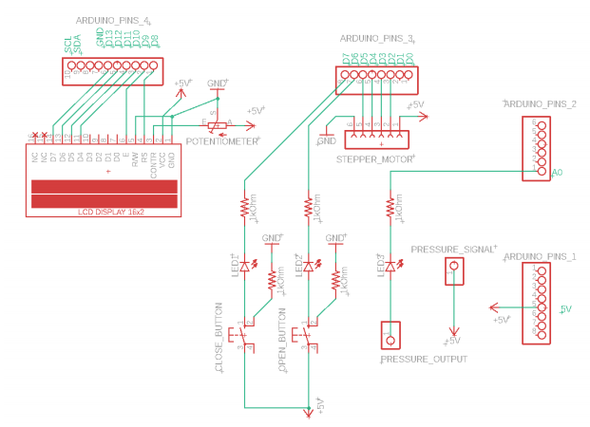
Pcb Design

Slide 7
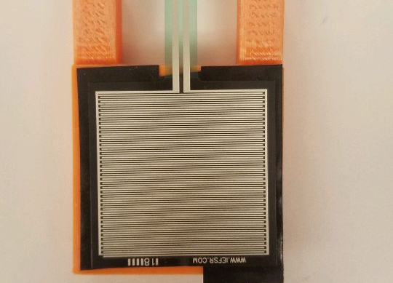
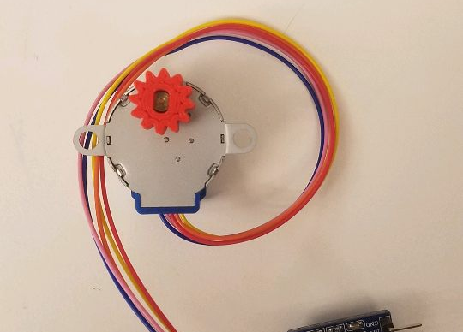
Sensors and Actuators
Actuator:
Stepper Motor Motion of the claw
Sensor:
Two Buttons Control state of claw
Potentiometer Control brightness of LCD
Pressure Sensor Measure grip on object

Slide 8
State Machine
Calibrate
Finds the closed and opened position for self
Stationary
Display size of object and waits for instruction
Open
Opens claw until max distance is reached
Close
Close until there is pressure on the claw or fully closed

Slide 9
Distance Calibration

Slide 10
Questions?

Slide 11
